Slide 1

The positive investor and I

Slide 2


Slide 3

Making a fortune here turning these old trees into toilet paper! Love Your money xx

Slide 4
Where you can be positive
Your bank account
2. Your savings account and ISAs
3. Your direct positive investments
4. Ethical funds
5. Your pension

Slide 5
The worst current accounts (/20)
Barclays | 2.5
First Direct | 2.5
HSBC | 2.5
Post Office | 2.5
Sainsburys | 2.5
NatWest | 2
Royal Bank of Scotland | 2
M&S Money | 1
Tesco | 0.5

Slide 6
The best current accounts (/20)
Triodos | 15.5
Cumberland Building Society | 13.5
Nationwide Building Society | 13.5
Clydeside Bank | 12.5
Metro Bank | 12.5
Yorkshire Bank | 12.5
Co-operative Bank and Smile Bank | 8.5

Slide 7

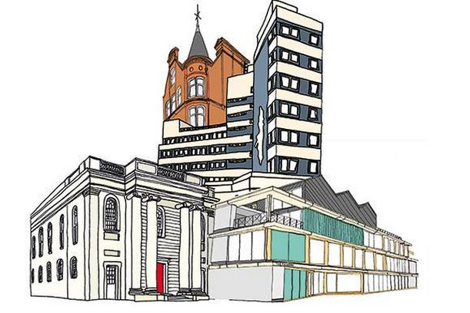

Slide 8
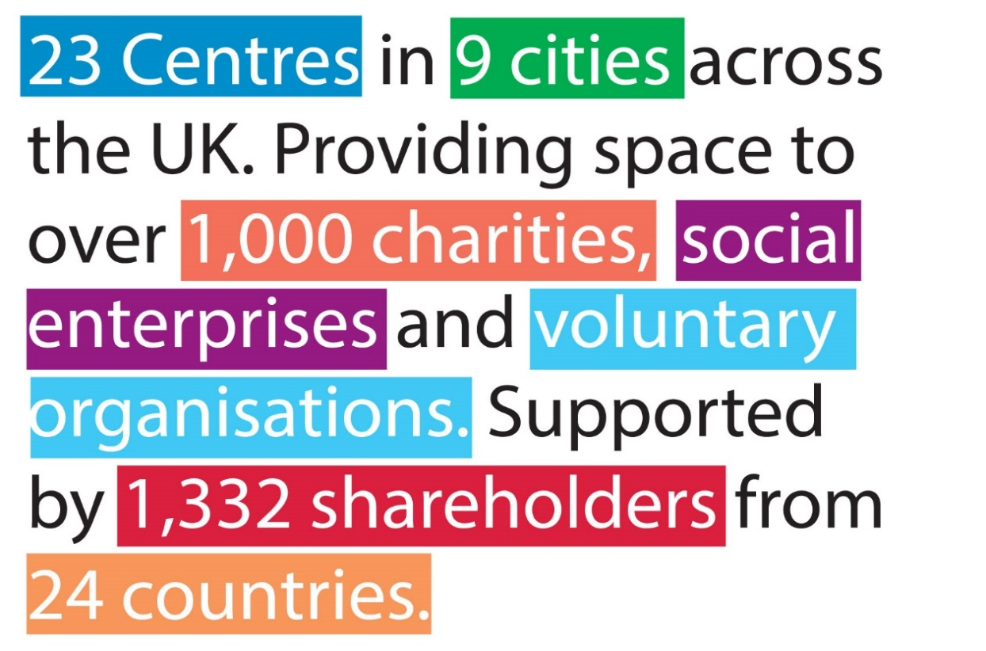
The Ethical Property Company
Founded in 1998

Slide 9

£65 million raised since 2013
www.ethex.org.uk
Notes:
Connect Hannah to investments like these.
Browse choose and compare
£50m raised and 10,000 investors
Nothing compared to the trillions invested in the stock exchange. How can we grow the market

Slide 10
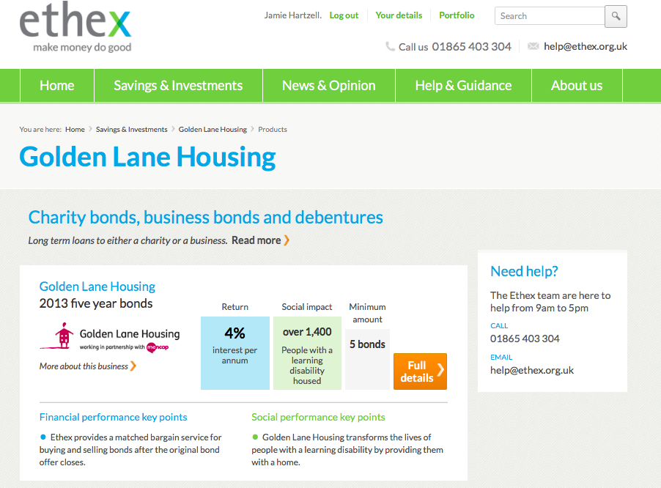
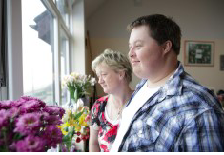
The positive investment & savings platform

Slide 11
The Ethical Stock Exchange
FTSE SECTOR | ETHICAL SECTOR
Aerospace and Defence | None
Communications and IT | Phone co-op, rural broadband co-ops
Finance and Insurance | Community and Ethical Finance, micro-credit
Food and Drink | Organic Food and Farming, Wholefoods
Health and Pharmaceuticals | Natural Health, care co-ops
Industrial Manufacture | Environmental technologies
Leisure and Media | Community radio and TV, eco-tourism
Oil Gas and Utilities | Community Renewables
Property and Construction | CLTs, Ethical Property, social housing
Forestry and Mining | Sustainable timber, recycling companies
Retailing | Fair trade, local shops, recycled & eco-produce
Transportation | Sustainable transport & fuels, car clubs

Slide 12

The language we use

Slide 13
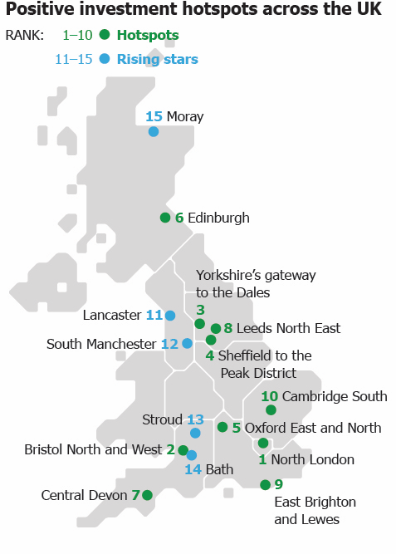
The hotspots for positive investing
Notes:
Site designed to take investors up ladder

Slide 14
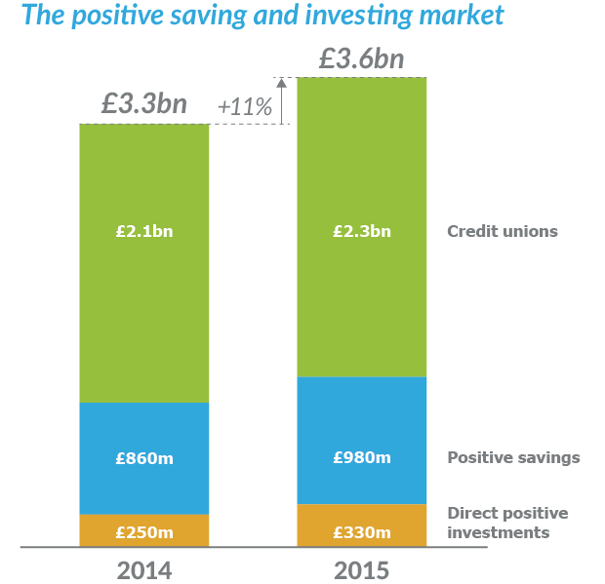
The positive saving and investing market

Slide 15
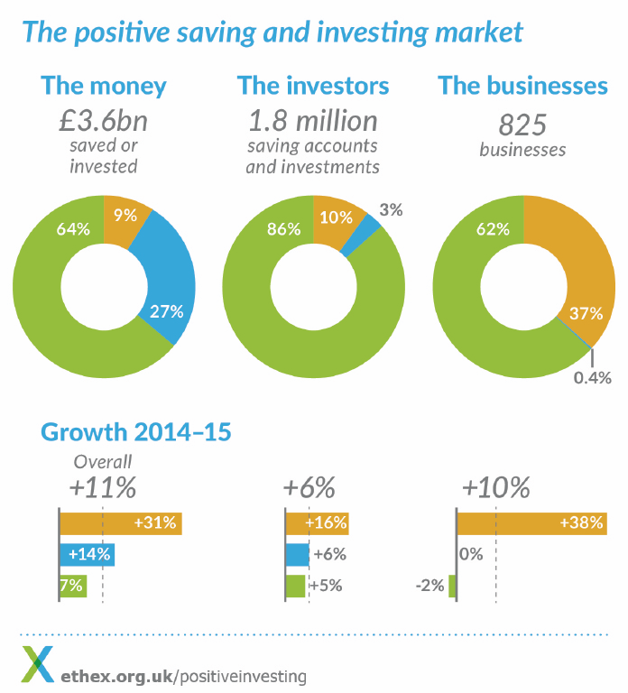
The existing community
10% of 1,550,000 credit union Members
60,000 positive savers
180,000 positive
Investments
20-40% of 646,000 Coop
Bank account holders
The committed:
Max 400, 000 people - Less than 1% of the UK population over 18

Slide 16
Age of the existing community
Notes:
Site designed to take investors up ladder

Slide 17
Median household wealth
Notes:
Site designed to take investors up ladder

Slide 18
UK market sizing
19.5 million people, 51% of the eligible population:
Choosing to save or invest positively | 20% | 7.8 Million
Of which looking to increase | 42% of the above | 3.2 million
Looking to save or invest positively for the first time | 39% | 11.7 million
Of which very interested | 21% of the above | 2.5 million
Notes:
Connect Hannah to investments like these.
Browse choose and compare
£50m raised and 10,000 investors
Nothing compared to the trillions invested in the stock exchange. How can we grow the market

Slide 19
Belief in positive social impact
Positive investment is seen as an effective choice:
Notes:
Site designed to take investors up ladder

Slide 20
Where do you prefer to have an impact?
Notes:
Site designed to take investors up ladder

Slide 21
The six types of positive investor
The Well-informed
The Progressive
The Receptive
Confident and knowledgeable with financial decisions
Wants measureable results
More investors than savers
The wealthiest
Want a strong financial return
Under 50 with a mortgage
Active in campaigns and Fairtrade
Strong believer in effectiveness of PI
Keen to explore new ideas
Want to live responsibly and be part of a group
Keen on social media
Female, under 40
Open to being convinced
Feel no great obligation to society
Not religious
Less keen on social action or Fairtrade
Outright home owners
Not planning to invest more
Notes:
Site designed to take investors up ladder

Slide 22
The six types of positive investor
The Skeptic
The Unsure
The Conscientious
Don’t believe in positive investment or social action
Believe in local impacts most
No interest in growing the market
Feel much of the money is wasted
The poorest and least educated
Male, over 50
Lack confidence in financial decisions
Low levels of positive investment
Lower levels of financial wealth
Younger, in part time employment
Don’t trust that the money is well used
Concerned about risk
More female
Strong sense of duty
Active Christians or Quakers
Decisions based on trust
The most interested in developing countries
60-80, outright home owners
Reluctant to try new things, no time
Notes:
Site designed to take investors up ladder

Slide 23
Size of each segment in the population
Notes:
Connect Hannah to investments like these.
Browse choose and compare
£50m raised and 10,000 investors
Nothing compared to the trillions invested in the stock exchange. How can we grow the market

Slide 24
Interest level in national population
57% said they were interested, of which 17% were very interested:

Slide 25
Are you willing to take a lower return?
33% are willing to take a lower return:
Notes:
Site designed to take investors up ladder

Slide 26
Segments by age
Notes:
Site designed to take investors up ladder

Slide 27
Growing the Sector –investment perspective
Community energy has been the predominant destination of community share investments in the last few years
  People know and understand green energy
  Income has been well forecast and supported
  Risks can be clearly defined
Community Land Trusts have the potential to move in this direction
  Asset backed
  Clear business model
  Supported rent in some cases
  Ability to have multi sites with different characteristics to meet community needs
  But potentially risky – delays/planning risk etc
Still requires more education, case studies, track record but it’s coming…slowly

Slide 28

Preference for local impact – CLTs?
& Community land trusts can cut across a number of desirable outcomes – affordable housing, community regeneration, old age support…++

Slide 29
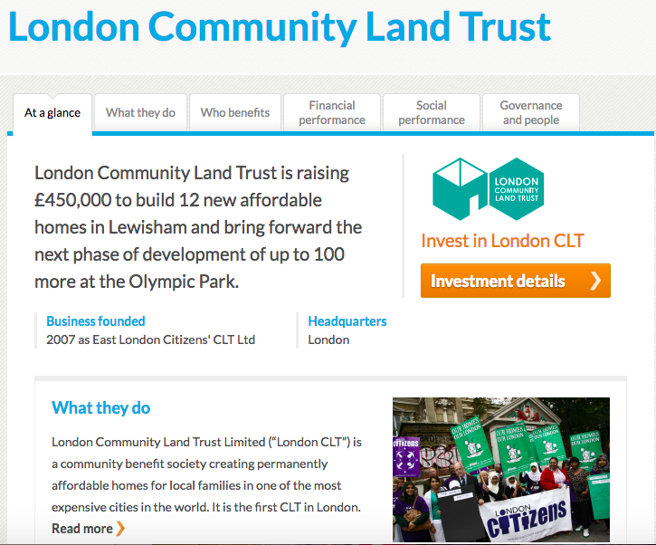
London Community Land Trust
Ground up community led approach
A number of land trusts working
together
Community shares raising £450k
Covers operational costs and at risk
pre development fees.
Lewisham targeted as primary site
Long lead-in times

Slide 30
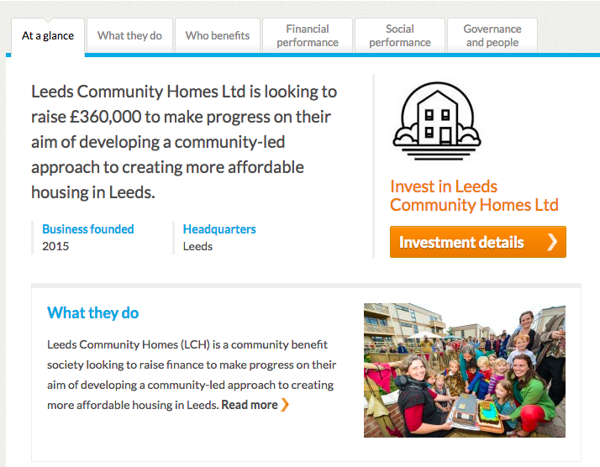
Leeds Community Homes
Land access approach to work with a developer through a section 106 agreement
Grant income covers some of initial pre dev. costs.
Rent 9 out of 16 homes and sell 7. Rented at “social rent” and sold at 2/3 of market value.

Slide 31
The next wave
Somerset CLT –Growing track record
St Ives CLT – Rural, blended finance model
Heart of Hastings CLT – Employment training, self build, SITR eligible (?)
  +Calder Valley CLT
  +…….

Slide 32

Imagining the mass market

Slide 33
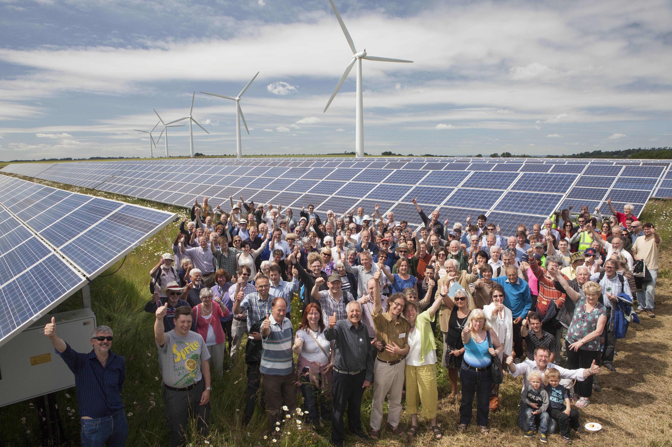
Imagining the mass market

Slide 34
